Slide 1
CARE Court and Behavioral Health Bridge Housing
May 15, 2024

Slide 2
Overview
Link individuals who have specific mental health diagnoses to county behavioral health services.
Under the oversight of a judge, for up to 24 consecutive months.
Includes an individualized treatment plan, supportive services and a dedicated team.
County Behavioral Health provides services and attends all hearings.
Community Assistance, Recovery, and Empowerment (CARE) Court Program – SB 1338 (Umberg)

Slide 3
Community Assistance, Recovery, and Empowerment (CARE) Court Program – SB 1338 (Umberg)
There are big differences between the public/media narrative around CARE Court and the actual provisions of SB 1338.
This will make it difficult for CARE Court to meet public expectations.
Cohort 1 counties have not seen large number of court ordered participants.

Slide 4
CARE Court Common Misunderstandings
Tension around the bill
Pro-patients’ rights - Seen as involuntary compulsory treatment.
Bill advocates - Seen as voluntary, the courts are just providing a “push” towards treatment.
Services already exist just not utilized.
Facts
Civil court process – no consequences for not showing for court or participating.
A voluntary agreement to enter treatment is priority.
No consequence for refusal to take medications as ordered.
Intensive programs (FSP) in our community are at capacity.
Potential community concerns
Expected frustration from families and petitioners who believe this is court ordered treatment that can be forced.
Misunderstanding of the criteria is another area that can lead to misunderstandings. Only for Schizophrenia or other psychotic disorders.

Slide 5
CARE Court Responsibilities Court and Behavioral Health
Civil Court
Receive CARE petitions
Determine basic eligibility within 10 days based on the information on the petition
Court hearings
Provide Courtroom, Judge, Clerk
Determination/Order to treatment
Public Defender
Ongoing court hearings every 60 days
Report court level data to state
Behavioral Health
Be present at all petition hearings
Serve the referred person with notice of hearing
Meet/find the referred person to complete an assessment to prepare report to the court
Complete a report to the court within 14 days of order (can be extended)
Use outreach to encourage voluntary participation
Create a care plan
Medications, intensive services, case management
Connect with Housing resources
Provide services for up to 2 years
Psychiatrist, medication manager, case manager, clinician
Intensive services –FSP averages 3x week contact
Attend progress hearings every 60 days
Connect with Housing resources
Report extensive individual participant data to state

Slide 6
CARE Court Treatment Requirements
Care Plan
“An individualized, appropriate range of community-based services and supports…which include clinically appropriate behavioral health care and stabilization medications, housing, and other supportive services, as appropriate.”
Case Management: DSS, SSI etc.
Treatment
Full Service Partnership (FSP)
Team includes: Case Manager, Clinician, Medication Manager, Psychiatrist
We will add one staff to augment existing FSP treatment (unknown number of participants)
Housing
SLO has received Bridge Housing
Care Court participants will be prioritized for beds in this funding

Slide 7
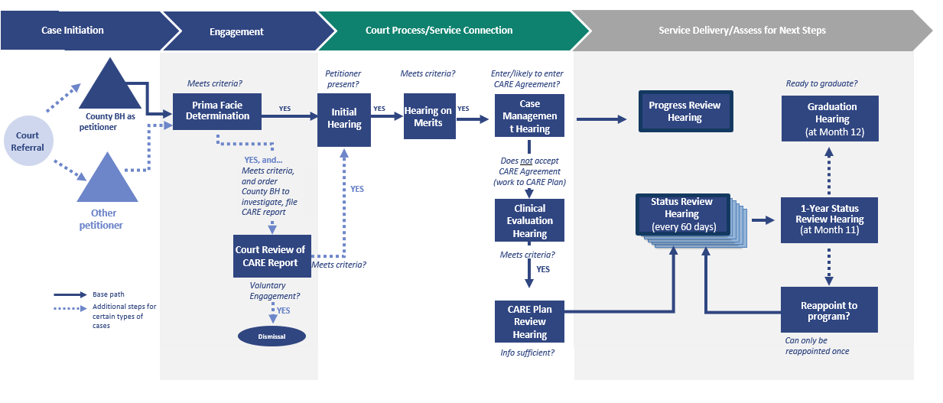
CARE Act Process

Slide 8
CARE Court Budget Impacts
Funding for services will be through Medi-Cal and through invoices to DHCS (State)
There will be process-related costs
Investigations, court hearing time
DHCS has created invoice process for services not billable through Medi-Cal
Increase Staffing
FSP level of care
One Case Manager -We will start by augmenting services in place by adding one staff vs a whole new team
Transportation
Vehicle – BH Staff to and from court, locating homeless referred individuals, going out to do assessments, transporting participants to court

Slide 9
CARE Court Accountability
Fines and Receivership: If County BH is not complying with court orders, the court may impose:
A fine of $1,000/day (up to $25,000 per violation). Fines will be placed in a state fund to be distributed to the County BH that paid the fine, for services to individuals with schizophrenia and psychotic disorders at risk of homelessness, incarceration, and/or conservatorship.
Receivership to secure court-ordered care for the Respondent, at the local county government’s cost (for persistent noncompliance by County BH, defined as more than five instances by the same entity in a year).
Appeals: The court must consider any mitigating circumstances impacting compliance with court orders and good faith efforts to come into compliance. County BH may appeal the court’s determinations.

Slide 10
CARE Court Implementation Planning
December to March: Civil court and BH leadership Planning.
Monthly meetings begin
Review court flow, program requirements, communication pathways between BH and civil court
Add key partners - DA’s office and PD’s office
April to June: Expand participating partners. Identify resources, connections, and services.
Agencies who will provide other support (i.e. Court Self-help center)
Data collection and reporting requirements
Process for Assessments, Assessment format, managing requests for extended time, inability to locate preferred party
July to September: Finalize planning, include community input.
Begin presentations to potential agencies involved First responders, Probation, Mental Health, APS, Public Guardian, etc.
Hiring and training for BH Treatment- 1 staff and training
Begin BH team meetings with involved partners BH case manager, BH clinician, BH supervisor, Bridge Housing team, Community Action Teams (CAT)
Begin community education, involvement, and outreach Contact agencies to provide presentations (NAMI, TMHA) BH webpage prepared and launched
October to December: Final launch readiness.
CARE Court: 1-2 days a week on the same day, in the same courtroom
BH Case Manager scheduled to present at all hearings and begin client outreach
Clinical staff prepared to provide Behavioral Health assessment and create report

Slide 11
Behavioral Health Bridge Housing
$7.5 million allocation to SLO County over 4 years (through FY 26-27)
Prioritize CARE Act program participants
Funding to operate housing to address immediate and sustainable housing needs of people experiencing homelessness who have serious behavioral health conditions
Short-term (less than 90 days) and mid-term housing (90 days-2 years)

Slide 12
Behavioral Health Bridge Housing
Contract with TMHA approved to operate the program
10 bed licensed housing facility (ATP II)- Sept 1, 2024
8 beds of rental assistance- summer 2024
Supportive services, housing navigation
County Behavioral Health
Program administration
Outreach and engagement
Clinical services, medication management

Slide 13
Behavioral Health Bridge Housing
Mid-Term
Licensed Housing 10 beds (3 years)
County funds, contractor operated
BH provides specialty SUD/MH services (on-site and outpatient)
Mid-Term
Rental Assistance 8 beds (3 years)
County funds, contractor operated
BH provides specialty SUD/MH services (outpatient)
Outreach and Engagement County Mental Health Nurse to augment existing Community Action Teams/Homeless Outreach & screen for program
Contract out:
Bridge housing operations
Rental assistance program and supportive services
Housing Navigation
County BH:
Program admin/ implementation and housing coordinator (1.00 FTE)
Expand outreach
(1.00 FTE)
Specialty BH services (2.00 FTE)
Contract NP services
1.00 FTE Nurse
5-10 hours/week Nurse Practitioner, 1.00 FTE BH Clinician, 1.00 FTE BH Specialist + contractor case management, supportive services, and housing navigation

Slide 14
Behavioral Health Bridge Housing
Next Steps:
TMHA completing renovations, obtaining licenses and leases for Bridge Housing units
All housing ready for occupancy by September 1, 2024
Potential for additional funds and Bridge Housing beds
County applied for $5 million of additional funds for more Bridge Housing beds
Focus of competitive grant application:
Add sober living and residential treatment beds and services
Expand rental assistance
Expand short-term shelter options (emergency shelter beds)
State awards will be announced in June/July

Slide 15
Contacts
CARE Court:
Teresa Pemberton, Division Manager
tpemberton@co.slo.ca.us
Behavioral Health Bridge Housing:
Morgan Torell, Business Analyst
mtorell@co.slo.ca.us

